Slide 1
ELEN 21/COEN 21: Introduction to Logic Design
Lectures 5 & 6: Adders, Multiplexers, Decoders and Encoders
Radhika S. Grover
Electrical Engineering Department
Santa Clara University
rgrover@scu.edu

Slide 2
Combinational Logic
Combinational circuit design
  Half and full adders
  Multiplexors
  Decoders
  Encoders
ELEN 21/COEN 21: Lectures 5-6

Slide 3
Binary adder-subtractor
Binary adder-subtractor performs addition and subtraction of binary numbers.
Half adder : adds two bits.
Full adder: adds three bits.
N-bit adder: connecting n full adders in cascade.
ELEN 21/COEN 21 Lectures 7 & 8

Slide 4
Half adder
Truth table
x y C S
ELEN 21/COEN 21 Lectures 7 & 8

Slide 5
Half adder cont.
K-map:
Boolean eqns:
ELEN 21/COEN 21 Lectures 7 & 8

Slide 6
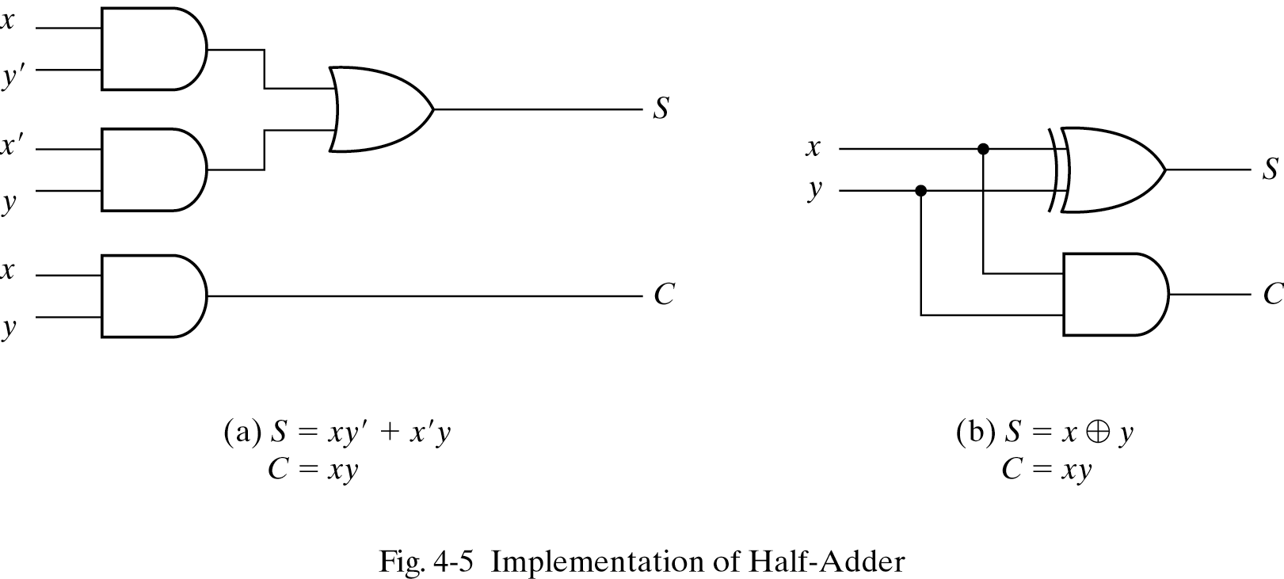
Half adder cont.
Implementation:
ELEN 21/COEN 21 Lectures 7 & 8

Slide 7
Full Adder
Truth table
x y z C S
0 0 0 0 0
0 0 1 0 1
0 1 0 0 1
0 1 1 1 0
1 0 0 0 1
1 0 1 1 0
1 1 0 1 0
1 1 1 1 1
ELEN 21/COEN 21 Lectures 7 & 8

Slide 8
Maps for Full Adder
ELEN 21/COEN 21 Lectures 7 & 8

Slide 9
Boolean Equations for Full Adder
ELEN 21/COEN 21 Lectures 7 & 8

Slide 10
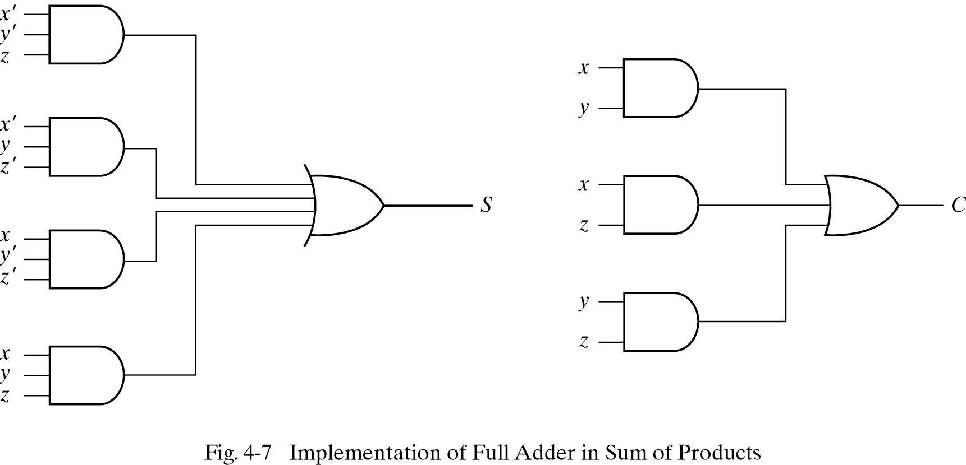
Implementation of full adder
ELEN 21/COEN 21 Lectures 7 & 8

Slide 11
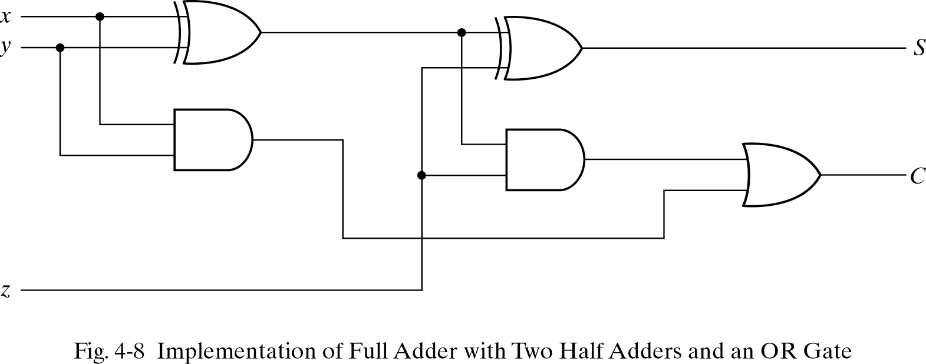
Alternate Implementation of full adder
ELEN 21/COEN 21 Lectures 7 & 8

Slide 12
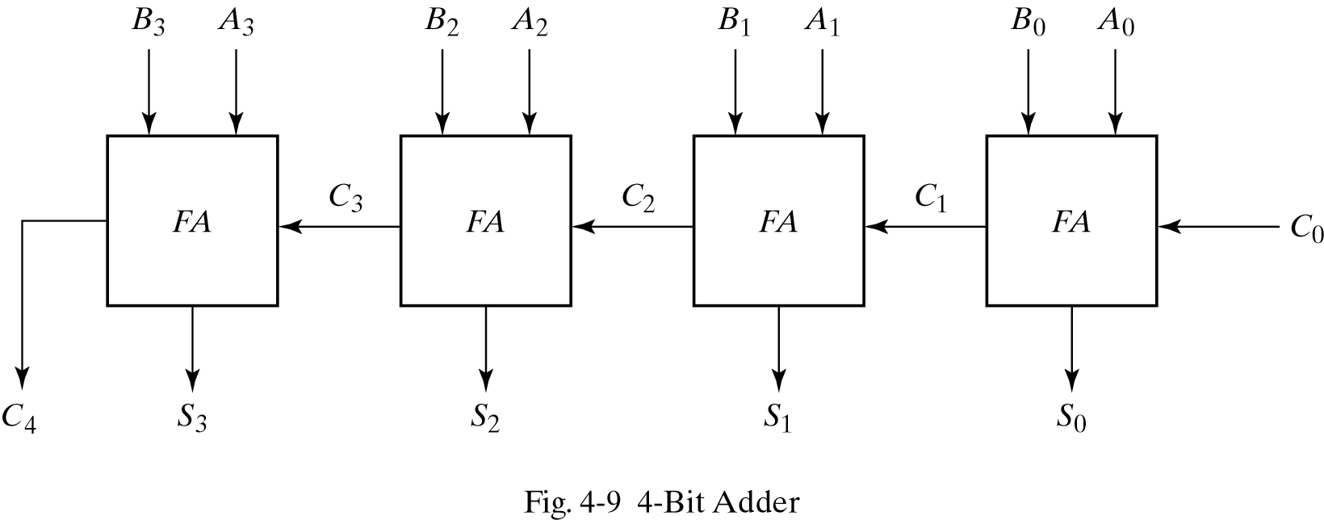
Binary Adder
A = 1011, B = 0011, C = and S =
ELEN 21/COEN 21 Lectures 7 & 8

Slide 13
Multiplexers
Combinational circuit that selects binary information from one of many input lines and sends it to a single output line.
Selection line decides which particular input line is to be selected.
Usually has 2^{n} input lines and n selection lines.
ELEN 21/COEN 21: Lectures 5-6

Slide 14
2-to-1-line Multiplexer
s
s
f
w
0
0
0
w
w
f
0
1
1
1
w
1
(a) Graphical symbol
(b) Truth table
w
w
0
0
s
f
s
w
1
w
f
1
(c) Sum-of-products circuit
(d) Circuit with transmission gates
ELEN 21/COEN 21: Lectures 5-6

Slide 15
4-to-1-line Multiplexer
s
0
w
0
s
1
s
0
s
1
s
1
s
0
f
w
w
1
0
00
0
0
w
0
w
1
01
f
0
1
w
1
f
w
2
10
1
0
w
w
3
11
w
2
w
2
1
1
3
(a) Graphic symbol
(b) Truth table
w
3
(c) Circuit
ELEN 21/COEN 21: Lectures 5-6

Slide 16
4-to-1 Multiplexer
Exercise: Use 2-to-1 multiplexers to build a 4-to-1 multiplexer.
s
1
s
0
w
0
0
w
1
1
0
f
1
w
2
0
w
3
1
ELEN 21/COEN 21: Lectures 5-6

Slide 17
Exercise: 8-to-1 Mux
Build an 8-to-1 mux using 2-to-1 muxes
ELEN 21/COEN 21: Lectures 5-6

Slide 18
Exercise: Eight-bit wide 2-to-1 Mux
Implement an eight-bit wide 2-to-1 mux.
ELEN 21/COEN 21: Lectures 5-6

Slide 19
Exercise: Three-bit wide 8-to-1 Mux
Implement a three-bit wide 8-to-1 Mux
ELEN 21/COEN 21: Lectures 5-6

Slide 20
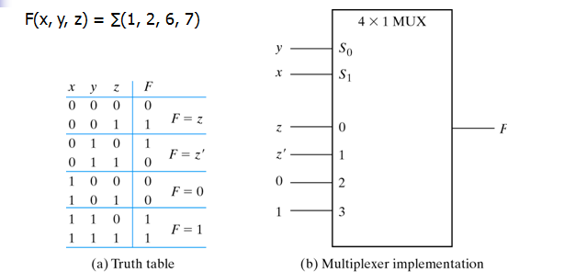
Implementing a Boolean Function with Multiplexer
ELEN 21/COEN 21: Lectures 5-6

Slide 21
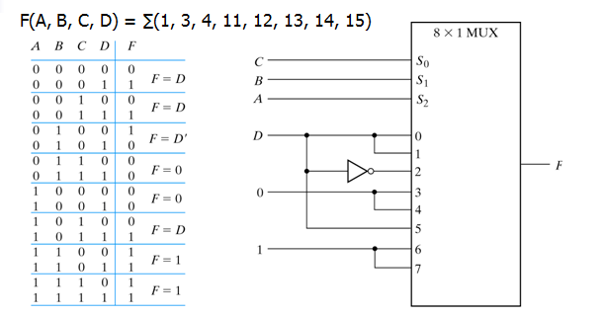
Implementing a 4-input function with a multiplexer
ELEN 21/COEN 21: Lectures 5-6

Slide 22
Decoders
A combinational circuit that converts binary information from n input lines to a maximum of 2^{n} unique output lines.
If n-bit coded information has unused combinations, decoder may have fewer than 2^{n} outputs.
Called m-to-n decoders where m ≤ 2^{n}
Example: 3-to-8 decoder
ELEN 21/COEN 21: Lectures 5-6

Slide 23
Truth table of 3-to-8-line Decoder
Inputs Outputs
x y z D₀ D₁ D₂ D₃ D₄ D₅ D₆ D₇
0 0 0 1 0 0 0 0 0 0 0
0 0 1 0 1 0 0 0 0 0 0
0 1 0 0 0 1 0 0 0 0 0
0 1 1 0 0 0 1 0 0 0 0
1 0 0 0 0 0 0 1 0 0 0
1 0 1 0 0 0 0 0 1 0 0
1 1 0 0 0 0 0 0 0 1 0
1 1 1 0 0 0 0 0 0 0 1
ELEN 21/COEN 21: Lectures 5-6

Slide 24
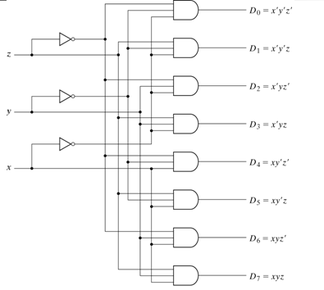
3-to-8-line Decoder
ELEN 21/COEN 21: Lectures 5-6

Slide 25
2-to-4 line Decoder with Enable Input
w
0
y
0
w
w
y
y
y
y
w
1
En
1
0
0
1
2
3
w
y
1
0
0
1
0
0
0
0
0
y
1
w
y
1
0
1
0
1
0
0
1
1
y
1
1
0
0
0
1
0
2
En
y
1
1
1
0
0
0
1
3
y
0
x
x
0
0
0
0
2
(a) Truth table
(b) Graphical symbol
y
3
En
(c) Logic circuit
ELEN 21/COEN 21: Lectures 5-6

Slide 26
Forming Larger Decoders with Smaller Decoders.
A 3-to-8 decoder using two 2-to-4 decoders
w
w
y
y
0
0
0
0
w
w
y
y
1
1
1
1
y
2
y
2
w
y
2
En
y
3
3
En
w
y
y
4
0
0
w
y
y
5
1
1
y
2
y
6
En
y
3
y
7
ELEN 21/COEN 21: Lectures 5-6

Slide 27
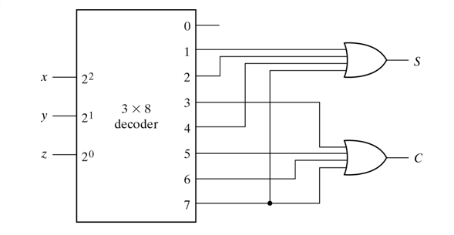
Implementing a Full Adder with a Decoder
ELEN 21/COEN 21: Lectures 5-6

Slide 28
Encoder
Digital circuit that performs the inverse operation of decoder.
An encoder has 2^{n} (or fewer input lines) and n output lines.
The output lines generate the binary code corresponding to the input value.
Example: 4-2 binary encoder
ELEN 21/COEN 21: Lectures 5-6

Slide 29
4-2 Binary Encoder
w
w
w
w
w
y
y
0
3
2
1
0
1
0
w
0
0
0
1
0
0
1
y
0
0
0
1
0
0
1
w
0
1
0
0
1
0
2
1
0
0
0
1
1
w
y
1
3
(a) Truth table
(b) Circuit
ELEN 21/COEN 21: Lectures 5-6

Slide 30
BCD-7 Segment Display Code Converter
w
3
w
2
w
1
w
0
a
b
c
d
e
f
g
a
a
0
0
0
0
1
1
1
1
1
1
0
w
b
0
0
0
1
0
1
1
0
0
0
0
0
c
f
b
0
0
1
0
1
1
0
1
1
0
1
w
1
d
0
0
1
1
1
1
1
1
0
0
1
w
g
2
e
e
c
0
1
0
0
0
1
1
0
0
1
1
w
3
f
0
1
0
1
1
0
1
1
0
1
1
g
d
0
1
1
0
1
0
1
1
1
1
1
0
1
1
1
1
1
1
0
0
0
0
(a) Code converter
(b) 7-segment display
1
0
0
0
1
1
1
1
1
1
1
1
0
0
1
1
1
1
1
0
1
1
(c) Truth table
ELEN 21/COEN 21: Lectures 5-6

Slide 31
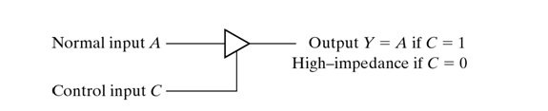
Three-State Gates
A multiplexer can be constructed with three-state gates.
A three-state gate is a logic device that exhibits three states.
Two states are logic 1 and logic 0 and the third state is a high-impedance state.
ELEN 21/COEN 21: Lectures 5-6

Slide 32
Summary
Designing decoders and encoders
Creating a larger decoder using smaller decoders
Use multiplexors to select one input out of many.
Can use multiplexors to implement a logic function.
ELEN 21/COEN 21: Lectures 5-6

